Slide 1
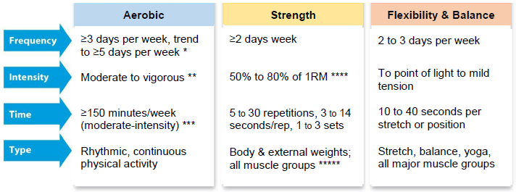
Rossmoor Wellness Group
Exercise & Healthy Aging
Use the FITT Principle to start or improve safe and effective exercise
Jim Grizzell, MBA, MA, MCHES®, ACSM-EP-C, F-ACHA - jimgrizzell@healthedpartners.org
Notes:
https://www.cdc.gov/physicalactivity/index.html
https://www.cdc.gov/physicalactivity/basics/older_adults/index.htm

Slide 2
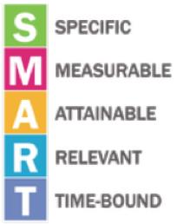
Learning Objectives
Participants will be able to:
  Consider selecting one (1) type of exercise to start or improve
  Use the SMART system to set an exercise goal
  Be able to describe the FITT components used for a safe and effective exercise program
    Frequency, Intensity, Time, Type

Slide 3


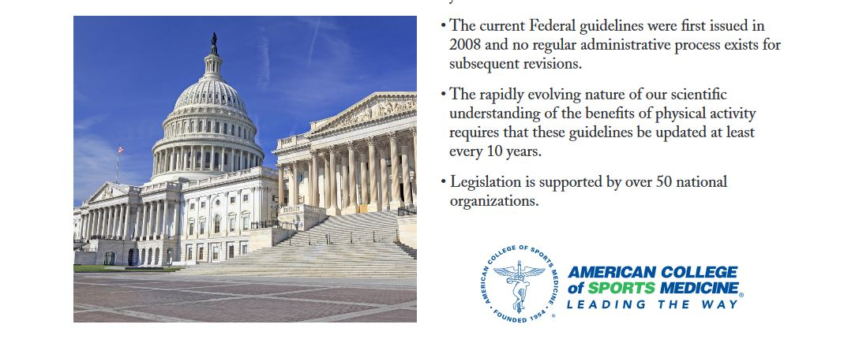
Agenda
Brief Review of the Science
  References, Health Benefits of Exercise
SMART Goal Setting
Ready to Go
  Tice Creek Fitness Center
FITT Principle
  Aerobic exercise, strength training, balance, flexibility
Questions and Answers
Notes:
The ACSM recommends that most adults engage in moderate-intensity cardiorespiratory exercise training for ≥30 min·d⁻¹ on ≥5 d·wk⁻¹ for a total of ≥150 min·wk⁻¹, vigorous-intensity cardiorespiratory exercise training for ≥20 min·d⁻¹ on ≥3 d·wk⁻¹ (≥75 min·wk⁻¹), or a combination of moderate- and vigorous-intensity exercise to achieve a total energy expenditure of ≥500-1000 MET·min·wk⁻¹. On 2-3 d·wk⁻¹,
https://journals.lww.com/acsm-msse/Fulltext/2011/07000/Quantity_and_Quality_of_Exercise_for_Developing.26.aspx

Slide 4
References and Resources

Slide 5
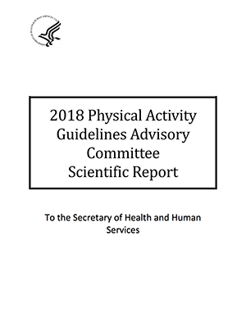
Chapter 4: Active Adults
  https://health.gov/paguidelines/guidelines/adults.aspx
Chapter 5: Active Older Adults
  https://health.gov/paguidelines/guidelines/older-adults.aspx
2018 Scientific Report for PAG Advisory Committee
  https://health.gov/paguidelines/second-edition/report.aspx
  Chapters 3. Brain Health and 9. Older Adults
  https://health.gov/paguidelines/second-edition/report/pdf/09_F-3_Brain_Health.pdf
  https://health.gov/paguidelines/second-edition/report/pdf/15_F-9_Older_Adults.pdf

Slide 6
Terminology
Physical Function
  Ability to conduct daily lives with energy and without undue fatigue
Multicomponent Physical Activity
  Combinations of balance, flexibility, strength, endurance, gait speed, chair rise time and physical function training, and recreation
Notes:
2018 Scientific Report: pages A-2 and F9-4
https://www.ncbi.nlm.nih.gov/pmc/articles/PMC3924230/

Slide 7
SMART Goal

Slide 8
Create your own healthy aging exercise program - Identify a SMART goal and write:
S: A specific FITT Type of exercise you feel strongly about doing
M: How will you measure it?
A: How realistic is it?
R: How does the goal meet your needs and interests?
  “Health is not the benefit” – Marshall Kreuter, PhD.
T: A target date to achieve it
Who will support your efforts?
What might be obstacles and solutions to achieving the goal.
Notes:
http://www.healthedpartners.org/ceu/sm/Cdcynergy/Content/activeinformation/videos/SOC_videos.htm
https://youtu.be/qAdOYNvoef4 stop at 32 seconds
https://www.sph.emory.edu/departments/bshe/events/dehaan-lecture-staff-pages/kreuter/index.html

Slide 9
First – Be Sure You’re Good to Go
Check with your doctor
Complete Rossmoor’s Tice Creek Fitness Center forms
  Physician Release
  PARQ – Physical Activity Readiness Questionnaire
  http://www.ticefitnesscenter.com/clearance-forms/
Schedule Training Sessions at Tice Creek Fitness Center
  Web site: http://www.ticefitnesscenter.com/
  Apps for your phone – Google Play and Apple iTunes
Provides for all types of healthy aging exercise:
aerobic,
muscle-strengthening and
multicomponent.

Slide 10
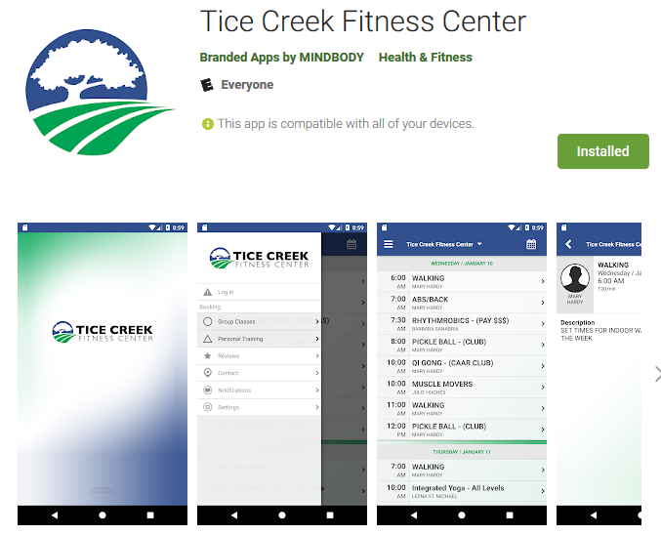
Tice Creek Fitness Center App
Plan and schedule your classes
View and sign-up for classes
Click through to our social pages
Optimize your time and maximize the convenience of signing up for classes from your device!

Slide 11
Benefits of Exercise
"Grade: Strong" evidence from the 2018 Scientific Report for the National Physical Activity Guidelines Advisory Committee.

Slide 12
Older Adult Health Benefits: PAGAC Grade: Strong* Evidence in the 2018 Scientific Report
Reduced risk of falls
Improved physical function and reduced age-related loss of physical function
Inverse dose-response relationship between volume of aerobic physical activity and risk of physical functional limitations
Aerobic, muscle-strengthening, and multicomponent physical activity improves physical function
Physical activity improves measures of physical function in older people with frailty and Parkinson’s disease
Notes:
Physical activity improves physical function among individuals of all ages, enabling them to conduct their daily lives with energy and without undue fatigue. Page A-2
Moderate evidence indicates that the risk of fall-related injury and bone fracture may be reduced using a variety of community-based group and home physical activities. Effective multicomponent physical activity regimens generally include combinations of balance, strength, endurance, gait, and physical function training, along with recreational activities. PAGAC Grade: Moderate. Page F9-4
Dose, Volume, and Dose-response for Aerobic Activities Page C-9 and C-10
Dose of aerobic physical activity is the type and amount of reported or prescribed physical activity
Dose is commonly calculated for a specific period of time, such as per day or per week, and, for aerobic activity, has been limited to moderate-to-vigorous physical activity because those are the intensities known to provide benefits. Increasingly, the acronym FITT, standing for frequency, intensity, time (duration), and type of activity (e.g., aerobic, muscle-strengthening) has been used to describe physical activity dose. 25
Volume
Volume is the quantification of the dose of activity accumulated over a specified length of time. Volume is usually expressed in MET-minutes or MET-hours per day or week. It is calculated by multiplying the physical activity frequency and duration by the MET values corresponding to that physical activity. For activities, such as walking or running, where a rate of energy expenditure at any given speed is a fixed amount, volume is sometimes simplified to minutes or hours of the activity, such as minutes per week of walking. Kilocalories per day or per week is used is used less frequently.
25. American College of Sports Medicine. ACSM’s Guidelines for Exercise Testing and Prescription. 8thed. Baltimore, MD: Lippincott Williams & Wilkins; 2009.

Slide 13
Older Adult Health Benefits: PAGAC Grade: Strong* Evidence in the 2018 Scientific Report
Moderate-to-vigorous physical activity have a transient benefits for cognition, attention, memory, crystalized intelligence, processing speed, and executive control
Greater amounts of physical activity are associated with a reduced risk of developing cognitive impairment, including Alzheimer’s disease
Notes:
Table E-1. 2018 Physical Activity Guidelines Advisory Committee Grading Criteria
Criteria Strong (text). See chart on slide 27 for Moderate, Limited, Not Assignable
Applicability
Study populations, exposures, and outcomes are directly related to the question
Generalizability (to the U.S. population of interest)
Studied population, exposure, and outcomes are free from serious doubts about generalizability
Risk of bias or study limitations (as determined by NEL BAT and/or AMSTARExBP)
Studies are of strong design; free from methodological concerns, bias, and execution problems
Quantity and Consistency (of the results across the available studies)
Many studies have been published and the results are highly consistent in direction and approximate size of effect
Magnitude and precision of effect
The magnitude and precision of the estimated effect provide considerable confidence in the accuracy of the findings

Slide 14
Older Adult Health Benefits: PAGAC Grade: Strong* Evidence in the 2018 Scientific Report
Physical activity improves health-related quality of life
Acute bouts of exercise can reduce state anxiety
Regular participation as well as longer durations of moderate-to-vigorous physical activity can reduce trait anxiety in adults and older adults
Physical activity interventions reduce depressive symptoms in individuals with and without major depression across the lifespan
Acute bouts of physical activity and regular physical activity improve sleep
Notes:
Strong evidence demonstrates that moderate-to-vigorous physical activity reduces the risk of developing major depression. It also reduces the symptoms of depression among individuals with and without clinical levels of depression. Similarly, moderate-to-vigorous physical activity reduces general feelings of anxiety (trait anxiety) among individuals with and without anxiety disorders. Acute episodes of moderate-to-vigorous physical activity also can reduce immediate feelings of anxiety (state anxiety). Page D-17
State and trait anxiety
When investigating human anxiety, the distinction between state and trait anxiety is most important. State anxiety can be defined as a transitory emotional state consisting of feelings of apprehension, nervousness, and physiological sequelae such as an increased heart rate or respiration (Spielberger 1979). Whereas everyone can experience state anxiety occasionally, there are large differences among individuals in the frequency, duration, and severity. State anxiety can be determined by several rating instruments developed in the past. Trait anxiety represents a fairly stable characteristic related to personality. Experiencing more frequently state anxiety combined with a general view of the world as being threatening and dangerous is used as marker of trait anxiety. The initiation and maintenance of trait anxiety have been related to several factors as outlined above.
https://www.sciencedirect.com/topics/neuroscience/trait-anxiety

Slide 15
FITT Principle
Frequency, Intensity, Time and Type for aerobic, muscle strengthening and multicomponent exercise.

Slide 16
Create Your Own Exercise Program:
Use the FITT Principle
FREQUENCY
  the number of times you engage in the activity per week
INTENSITY
  how hard your workout must be to achieve the desired results
TIME
  how many minutes or repetitions of an exercise are required to attain the desired fitness level
TYPE
  what kind of exercise should be done

Slide 17
Likely 5, 6 or 7 days per week may be most effective
Inactive adults may need to start with 5 minutes several time per day and 5, 6 or 7 days per week

Slide 18
Use talk test, perceived exertion or heart rate
  www.cdc.gov/physicalactivity/basics/measuring/index.html
Moderate would allow some talking. You would not be able to sing.
  50% to 70% of MHR
Vigorous would make talking difficult
  70% to 85% of MHR
Moderate may be best for brain health
Notes:
For ease of use in non-clinical settings, the sing-talk test is the simplest. During light-intensity activities most people are able to sing, during moderate-intensity they can talk but not sing, and during vigorous activities, even talking is difficult. Scientific Report page C-9
https://youtu.be/GEvJlmpZCoM?t=1m44s
https://youtu.be/GEvJlmpZCoM?t=2m40s

Slide 19
For substantial health benefits, adults should do
150 to 300 minutes a week of moderate-intensity, or
75 to 150 minutes a week of vigorous-intensity
Aerobic activity should be performed in episodes of at least 10 minutes, and preferably, spread throughout the week.
Notes:
Appropriate Physical Activity Intervention Strategies for Weight Loss and Prevention of Weight Regain for Adults
Evidence supports moderate-intensity PA between 150 and 250 min·wk⁻¹ to be effective to prevent weight gain. Moderate-intensity PA between 150 and 250 min·wk⁻¹ will provide only modest weight loss. Greater amounts of PA (>250 min·wk⁻¹) have been associated with clinically significant weight loss. Moderate-intensity PA between 150 and 250 min·wk⁻¹ will improve weight loss in studies that use moderate diet restriction but not severe diet restriction. Cross-sectional and prospective studies indicate that after weight loss, weight maintenance is improved with PA >250 min·wk⁻¹.
https://journals.lww.com/acsm-msse/Fulltext/2009/02000/Appropriate_Physical_Activity_Intervention.26.aspx
the target range has been commonly expressed as 150 to 300 minutes of moderate-intensity physical activity per week. Because vigorous-intensity physical activities (6 or more METs) require roughly twice the energy expenditure of moderate-intensity activities (3 to less than 6 METs), the time required to perform 500 to 1,000 MET-minutes of vigorous-intensity physical activity is roughly half that for moderate-intensity physical activity. As a result, about 75 to 150 minutes of vigorous-intensity physical activity per week is considered within the target range. PAG Page D-8
For even greater health benefits, do one of the following:
Increase moderate-intensity aerobic physical activity to 300 minutes (5 hours) each week
Increase vigorous-intensity aerobic physical activity for 150 minutes (2 hours and 30 minutes) each week
https://health.gov/paguidelines/guidelines/adults.aspx

Slide 20
Most rhythmic & continuous
  Walking
  Cycling – indoor, road, paths, trails
  Swimming
  Rowing
  Jogging
  Water aerobics
  Aerobic dance
Others (some stop & go)
  Tennis, pickleball
  Pushing lawnmower
  Golf without cart
  Gardening
PA Guidelines Video (4:46 min)
Notes:
https://youtu.be/GEvJlmpZCoM

Slide 21
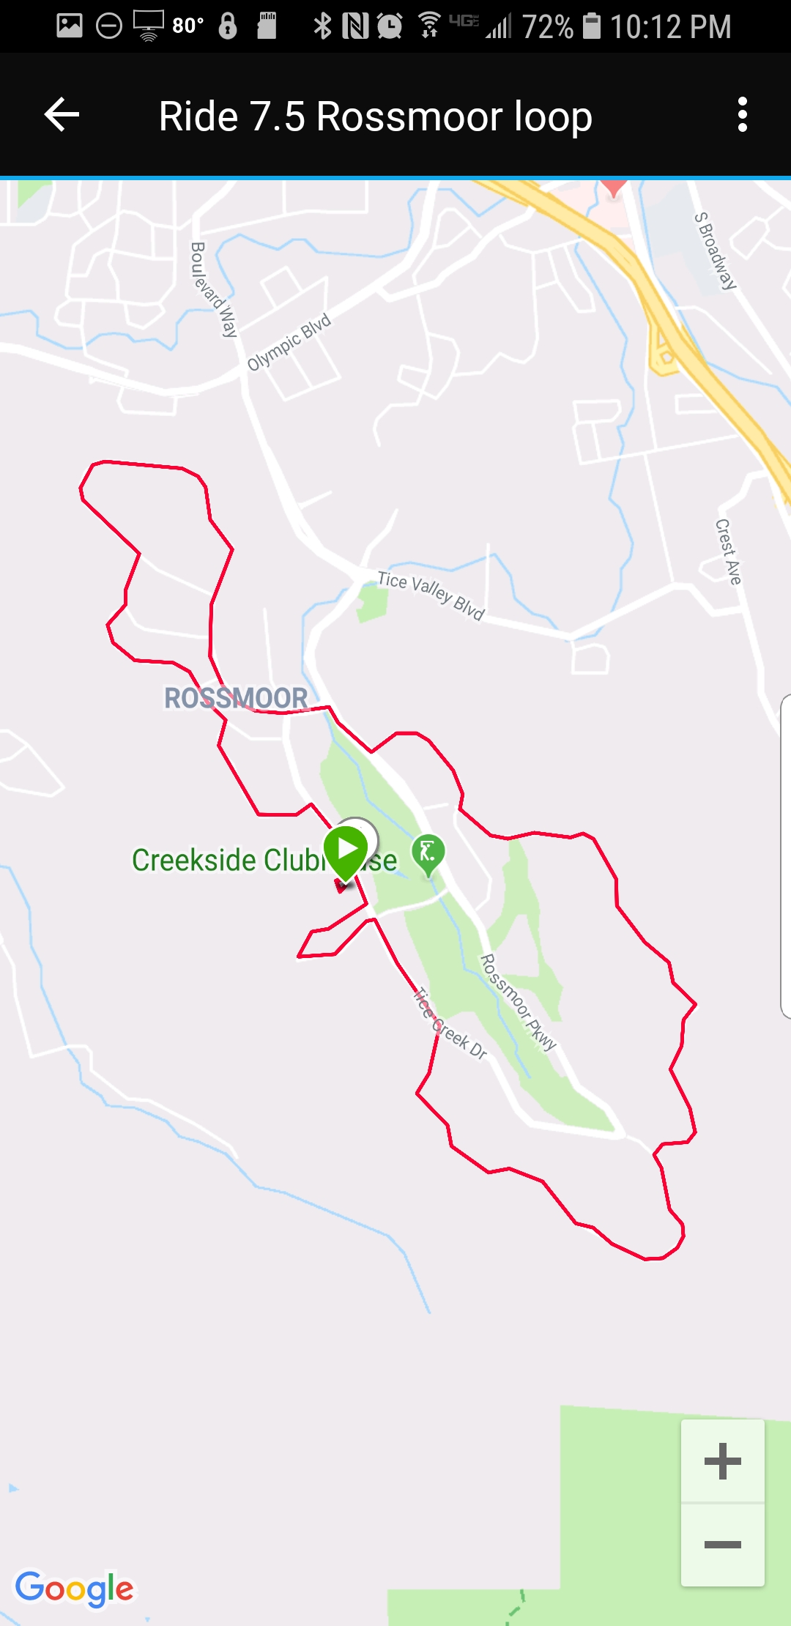
Walk, Jog, Bike, Wheelchair Rossmoor
7.5 mile loop

Slide 22
Every 3rd or 4th day
DOMS – Delayed Onset Muscle Soreness
  If use resistance to your RM (Repetitions Maximum, can’t do another repetition in same form as first repetition)
  May get DOMS
    Complete recovery likely by 3rd or 4th day

Slide 23
50% of 1 RM would allow about 30 repetitions (reps)
80% of 1 RM would allow about 10 reps
ACSM Position Statement: 8 to 12 reps per set to induce muscle fatigue
Notes:
What duration of rest intervals between sets and intensity is appropriate to improve muscular fitness?
For a general fitness program, rest intervals of 2-3 min are most effective for achieving the desired increases in muscle strength and hypertrophy (¹³). Robust gains in both hypertrophy and strength result from using a resistance equivalent to 60%-80% of the individual's one-repetition maximal (1RM) effort (³⁸⁶). For novice through intermediate strength trainers, a load of 60%-70% of the 1RM is recommended (i.e., moderate to hard intensity), while experienced exercisers may work at ≥80% of the 1RM (i.e., hard to very hard intensity) (¹³). The selected resistance should permit the completion of 8-12 repetitions per set-or the number needed to induce muscle fatigue but not exhaustion. For people who wish to focus on improving muscular endurance, a lower intensity (i.e., <50% of 1RM; light to moderate intensity) can be used to complete 15-25 repetitions per set, with the number of sets not to exceed two (⁵⁹). Table 5 shows the relative intensities for resistance training.

Slide 24
3 to 14 seconds per rep
10 reps at 80% 1RM intensity in 24 to 50 seconds
30 reps at 50% 1RM intensity in 90 to 150 seconds
4 to 6 slow repetitions with 14 seconds per repetition can be effective and safe
Notes:
What duration of rest intervals between sets and intensity is appropriate to improve muscular fitness?
For a general fitness program, rest intervals of 2-3 min are most effective for achieving the desired increases in muscle strength and hypertrophy (¹³). Robust gains in both hypertrophy and strength result from using a resistance equivalent to 60%-80% of the individual's one-repetition maximal (1RM) effort (³⁸⁶). For novice through intermediate strength trainers, a load of 60%-70% of the 1RM is recommended (i.e., moderate to hard intensity), while experienced exercisers may work at ≥80% of the 1RM (i.e., hard to very hard intensity) (¹³). The selected resistance should permit the completion of 8-12 repetitions per set-or the number needed to induce muscle fatigue but not exhaustion. For people who wish to focus on improving muscular endurance, a lower intensity (i.e., <50% of 1RM; light to moderate intensity) can be used to complete 15-25 repetitions per set, with the number of sets not to exceed two (⁵⁹). Table 5 shows the relative intensities for resistance training.

Slide 25
Machines, body weight, bar/dumbbells, bands
All Muscle Groups
  Alternate exercises for
    Lower
    Upper
    Front
    Back
Multiple joint exercises
  Shoulder and elbow
  Hip and knee

Slide 26
Multicomponent
Physical
Activity

Slide 27
Multicomponent
Physical
Activity

Slide 29
Learning Objectives
Participants will be able to:
  Consider selecting one (1) type of exercise to start or improve
  Use the SMART system to set an exercise goal
  Be able to describe the FITT components used for a safe and effective exercise program
    Frequency, Intensity, Time, Type

Slide 30
This PowerPoint and other resources are available at: www.healthedpartners.org/ceu/pa-healthyaging
Questions and Answers
Jim Grizzell, MBA, MA, MCHES®, ACSM-EP-C, F-ACHA - jimgrizzell@healthedpartners.org

Slide 31
Learning Activity
What is one (1) FITT principle you might try to do to improve or maintain your health in the next three (3) months?

Slide 32
Table E-1. 2018 Physical Activity Guidelines Advisory Committee Grading Criteria (page E-21)

Slide 33
How to Burn the Most Fat

Slide 34
Fat Cells
30 - 40 billion
Volume from fat: 83% to 95%
Fat
Nucleus & Cytoplasm

Slide 35

Fat Cells
30 - 40 billion
Volume from fat: 83% to 95%
Goal
  get fat out to muscles
  don’t replace all of it
Fat
from fat grams
to muscles to use as fuel (ATP)

Slide 36
Calories Burned per Minute

Slide 37
Training Effect of Regular Exercise
Beginning Exerciser

Slide 38
Training Effect of Regular Exercise
Regular Exerciser
Beginning Exerciser

Slide 39
Training Effect of Regular Exercise
Mitochondria in Muscle Cells
Non-Exerciser
  10% - 15% mitochondria
Exercise Walker
  20% - 25% mitochondria
Marathon Runner
  30% - 35% mitochondria
Better fat burning thru chemistry!

Slide 40
Burn More Fat at Higher Intensities

Slide 41
Burn More Calories at Higher Intensities

Slide 42
Burn More Calories at Higher Intensities
15 miles per hour
10 miles per hour

Slide 43
Burn More Fat at Very High Intensities

Slide 44
To lose fat, should I wear . . .
sweats?
vinyl suits?
rubber belts?
just shorts & a t-shirt?
If I keep real warm do I melt fat
  like melting butter in a pan on a stove?

Slide 45
Burn More Fat in Cold Temps

Slide 46
Burn More Total & Fat
Calories with Aerobic Exercise

Slide 47
Key Concepts
Window for opportunity for beneficial health effects from exercise is broad across the lifespan and extends to people who become active later in life
Exercise must be regular and tend toward being mostly moderate
  You may need to start with 5 minutes very light intensity several times a day
AVOID INACTIVITY
  Do aerobic and muscle-strengthening exercise, and include balance and flexibility exercises.
  Time doing flexibility exercise does not count toward meeting aerobic and strengthening guidelines.

Slide 48
Time Efficient Recommended Strength Workout by Mary Schreiber, PhD
Major muscle groups, big muscles and big muscle groups, multiple joint exercises
Alternate exercises
  lower, upper, front and back of body
Rotate through all exercises for 1 to 3 sets
Abs (front)
Leg press (front & back upper legs) & calf press (back of lower legs)
Chest press (front chest, back of arms)
Leg extension (front upper leg)
Seated row (front of arms, back of shoulders)
Back extension (low back, butt)
Leg curl (back of lower legs)
Overhead press (top of shoulders, back of arms)
Dorsiflexion (front lower leg)
Lat pull (arms front, back)
https://connect.garmin.com/en-US/signin

Slide 49
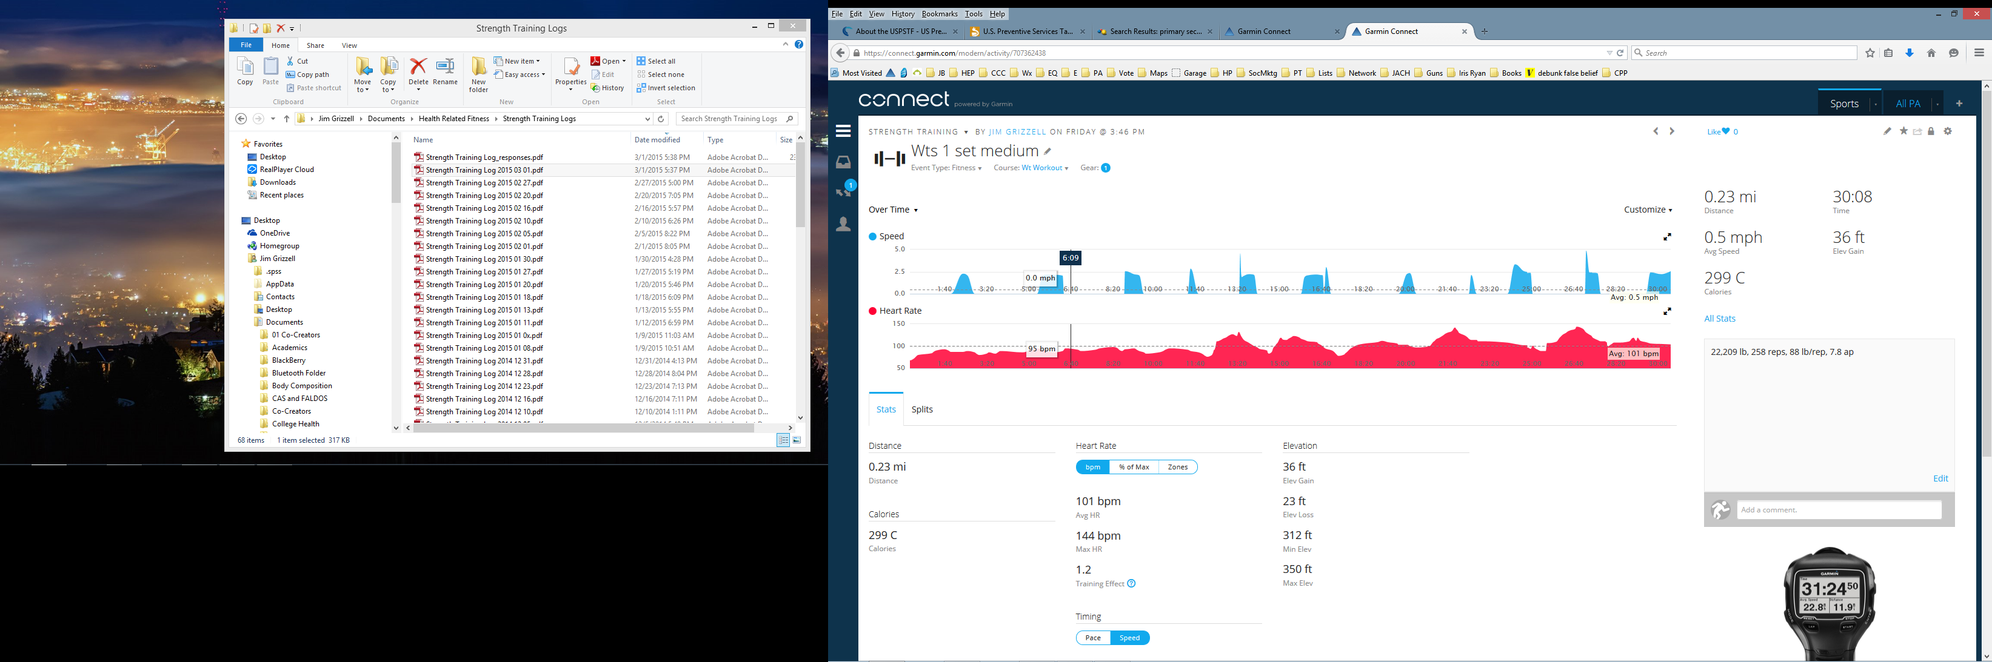
1 Set of 11 Exercises in 30 Minutes
22,209 lb, 258 reps, 88 lb/rep, 299 calories

Slide 50
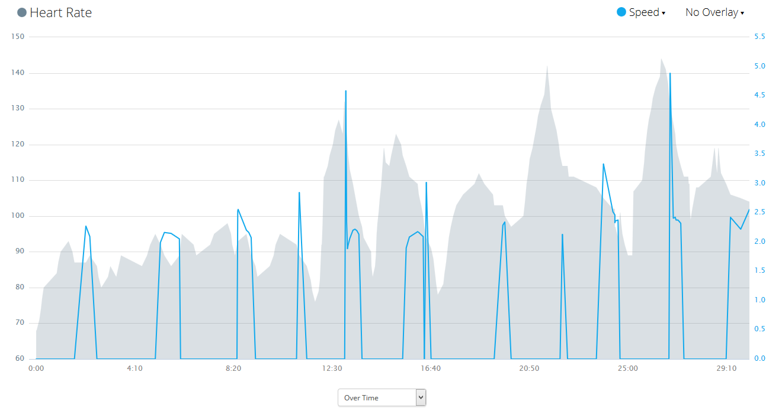
1 Set of 11 Exercises in 30 Minutes
22,209 lb, 258 reps, 88 lb/rep, 299 calories
Walking to next exercise
Leg press, calf press
Leg extension
Back extension
Overhead press
Chest press
Seated row
Dorsiflexion
Leg curl
Lat pull
Abs
Abs
Heart Rate
Walking to next exercise
Walking to next exercise

Slide 51
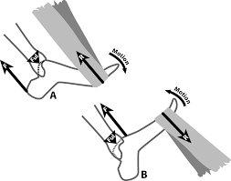
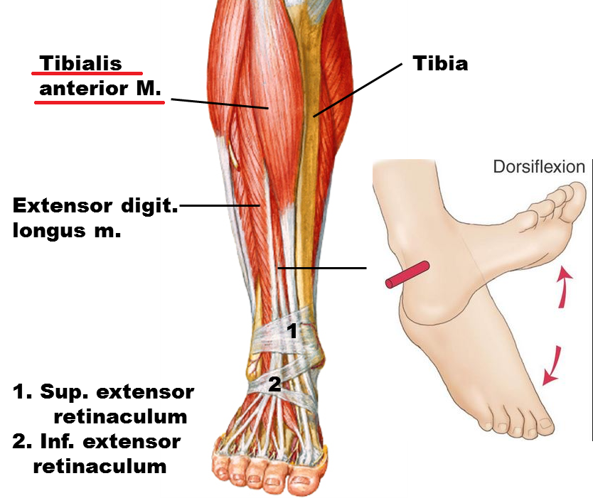
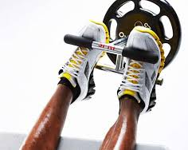
Dorsiflexion
Solving the Riddle of the Shin Splint
Strengthen the muscles on the front of the lower leg, the anterior tibalis. Use things like the D.A.R.D. (Dynamic Axial Resistance Device), and thera-bands in every color of the spectrum. Neither of these resistance protocols helped.
https://simplifaster.com/articles/solving-the-riddle-of-the-shin-splint/
https://youtu.be/QdQvsmKtewI

Slide 52
Benefits of Combined
Diet + Aerobic & Strength Exercise
Diet Only
Diet + Aerobic Exercise
Diet + Aerobic + Strength Exercise

Slide 53
Benefits of Combined
Diet + Aerobic & Strength Exercise
Diet Only
Diet + Aerobic Exercise
Diet + Aerobic + Strength Exercise

Slide 54
Benefits of Combined
Diet + Aerobic & Strength Exercise
Diet Only
Diet + Aerobic Exercise
Diet + Aerobic + Strength Exercise

